Slide 1
Fundamentals of Professional Contracts

Slide 2
Objectives
Laws that Govern
Different Types of Professional Service Contracts
Submitting to OSP
Contract Requirements
Performance Evaluations
Amendments
Emergency Contracts
Sole source
Common Mistakes

Slide 3
Laws that Govern Professional Contracts
Louisiana Constitution
Louisiana Revised Statutes 39:1551-1755
Louisiana Administrative Code Title 34, Part V
Executive Orders
JML 24-113: Cooperative Endeavors
JML 24-115: Line Item Appropriations CEA
Notes:
Explain executive orders meaning

Slide 4
Applicability of Law
All expenditures of public funds by the Executive Branch of the State, regardless of their source, must follow the laws that govern OSP-PC contracts.
Some exemptions in law
R.S. 39:1554
R.S. 39:1619 – Social Services
Contracts over the Agency’s Delegated Authority must be processed by OSP.
Notes:
Most agencies have a DPA of $5000,
Contracts that don’t have to come to OSP still need to follow Purchasing laws

Slide 5

Types of Contracts
Professional
Personal
Consulting
Social Services
Interagency
Intergovernmental
Cooperative Endeavors

Slide 6
Professional
Lawyers
Doctors
Dentists
Psychologists
Certified Advanced Practice Nurses
Veterinarians
Architects
Municipal Advisors
Engineers
Land Surveyors
Landscape Architects
Accountants
Actuaries
Claims Adjusters
Pharmacists
Visiting Professors

Slide 7
Personal
Graphic Artist
Sculptor
Musician
Photographer
Writer
Handwriting Analyst
Court Reporter
Foreign Representative
Expert Witness
Paramedical
Therapist
Private Investigator
Sign Language Interpreter
Entertainers
Expert Speaker

Slide 8
Consulting
Work by an individual or firm who possess specialized knowledge, experience or expertise to investigate assigned problems; to provide counsel, review, design, development, analysis, or advise in formulating and implementing programs or services or improvements to programs and service.
Appraisers
Finance (Banking Services)
Planning
Data Processing (IT)
Advertising
Public Relations
Scientists

Slide 9
Social Services
Rehabilitation and Health Support
Habilitation & Socialization
Protection for Adults and Children
Improvement for Living Condition and Health Services
Evaluation, Testing, and Remedial Educational Services

Slide 10

Interagency Contracts
Between executive branch state agencies
Must be submitted to OSP for review
Exempt from RFP regardless of value

Slide 11
Intergovernmental Contracts
Between state agency and another governmental agency (local, state or federal)
Exempt from OSP review and approval under R.S. 39:1554 J.2 except for procurement of social services
These agreements can be with police juries and other parishes, as well as other states

Slide 12

Cooperative Endeavor Agreements (CEA) “Cooperative endeavor” means any agreement to which the state is a party and pursuant to which the state has obligated state resources, whether funds, credit, property, or things of value of the state to a nonpublic person for the accomplishment of a purpose or in the public interest.”
All CEAs with expenditure of funds
must come to OSP
JML 24-113
Must be sent to OSP for approval
JML 24-115
Line Item Appropriation CEA’s
Format and Guidelines
https://www.doa.la.gov/media/y33lrldu/liatemplate2024.docx
https://www.doa.la.gov/media/mjgpylgs/cea-template-10-30-24.docx
Notes:
If asked what does expenditure of funds means, tell them to ask their legal dept.

Slide 13
Cooperative Endeavor Agreements (CEA)
Louisiana Constitution Art. VII, §14 (A) generally prohibits the state and its political subdivisions from donating public funds or property
CEAs must meet the 3-prong Cabelas test (Louisiana Supreme Court case) for a public entity to properly expend or transfer public funds or property.
Expenditure or transfer must be for public purpose that the entity has legal authority to do
Expenditure or transfer of public funds or property, taken as a whole, does not appear to be gratuitous
Evidence must demonstrate that the public entity has a demonstrable, objective, and reasonable expectation of receiving a benefit or value at least equivalent to the amount expended or transferred
Notes:
If asked what does expenditure of funds means, tell them to ask their legal dept.

Slide 14
Determining When an RFP is Required
Interagency, Intergovernmental, Personal and Professional Contracts are exempt from the RFP Process
Consulting service contracts greater than $74,999.99 in a 12 month period (maximum $224,997 in 36 months), require an RFP. See Louisiana R.S. 39:1621.
Social Services contracts greater than $249,999.99 in a 12 month period (maximum $749,997 in 36 months) require an RFP unless specifically exempt in accordance with Louisiana R.S. 39:1619.
Notes:
Contracts for Interagency services may be awarded without the necessity of competitive bidding or competitive negotiation

Slide 15
Submitting to OSP
Agency creates shopping cart
Agency converts to PO
PO goes through appropriate approvals
OSP receives and reviews
Important Note:
If a PO is returned to the Agency for attachment changes, the agency should not edit the PO
The agency should use the versioning method in LaGov
In the LaGov PO make sure to fill in the Selection Process
Can be either Non-Competitive or Competitive (RFP)
Navigate to: Header - General Data Tab
Notes:
Make sure the appropriate service type is selected when submitting:
PRO, PER, CON, SOC, AGY, GOV, CEA

Slide 16
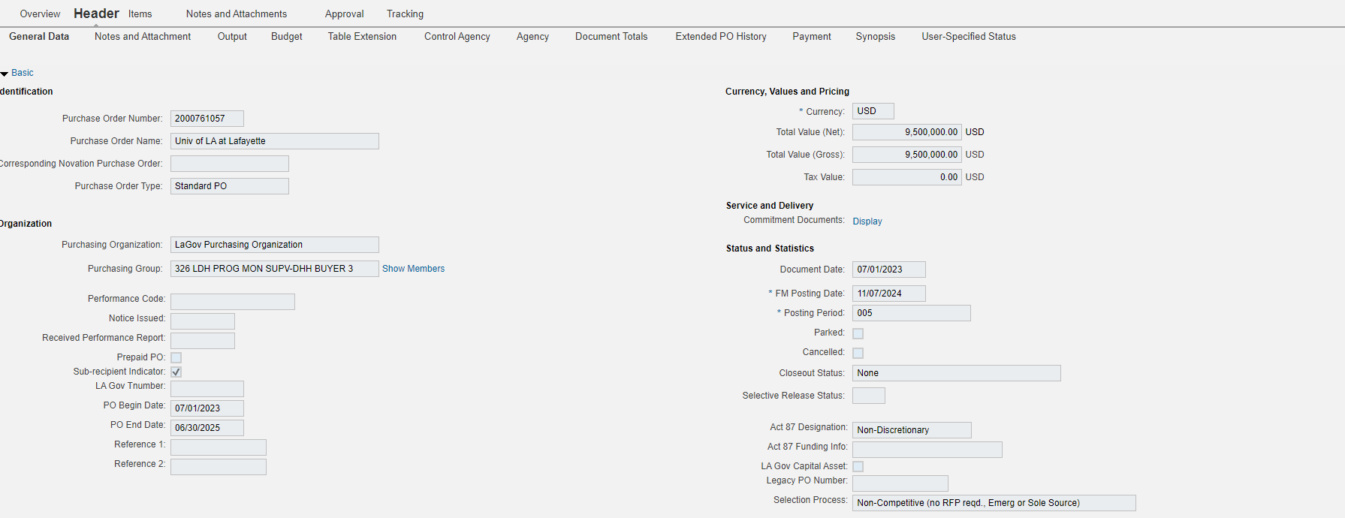
Submitting to OSP -LaGov

Slide 17
Appropriate Approvals
Department of Revenue
Attorney General
Office of General Counsel
Civil Service
Office of Planning and Budget

Slide 18
Minimum Contract Requirements
Beginning & Ending Dates
Deliverables & Schedule
Statement of Work
Maximum Amount & Schedule of Payments
Monitoring Plan
Responsibility of Taxes
PPM 49 - Travel Requirements
Contract Clauses:
Anti-Discrimination
Assignability
Boycott of Israel
Discrimination of Firearms
Fiscal Funding
Legislative Auditor
Remedies for Default
Termination

Slide 19
Contract Attachments
Transmittal Letter
Certification Letter
Late Letter
Multi-Year Letter
Disclosure of Ownership
Certificate of Authority
Out of State Justification
Vendor Profile Data Form
Prior Performance Evaluation
BA-22 Form
Resume for Consultants
Board Resolution

Slide 20
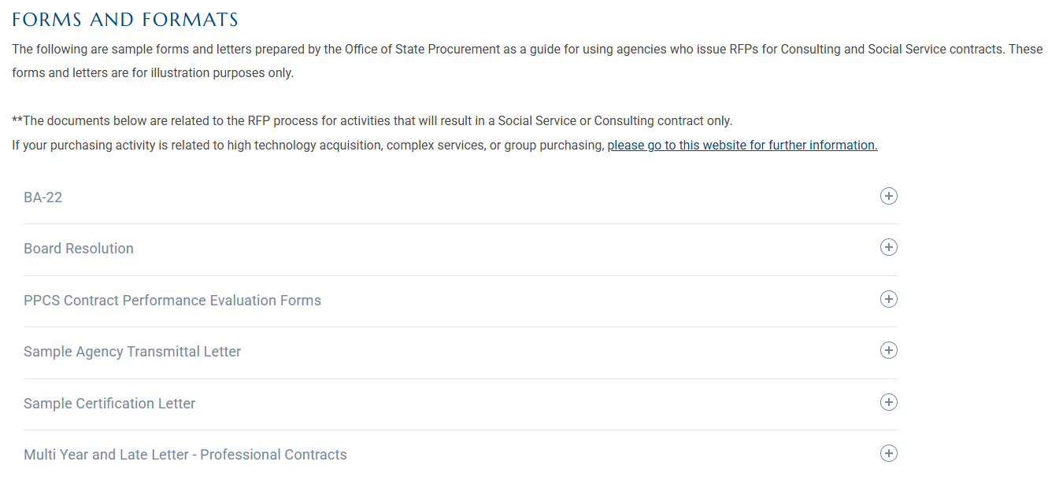
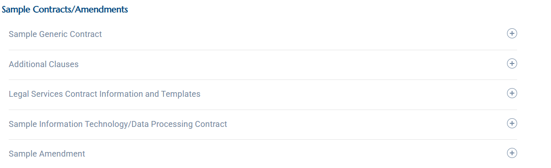
Forms

Slide 21
Submitting Amendments to OSP - LaGov
Attach to contract PO
PO goes through approvals
OSP receives and reviews

Slide 22
Submitting Amendments to OSP - ProAct
Create new transmittal
PO goes through approvals
OSP receives and reviews
Notes:
Emphasize not everyone uses ProAct

Slide 23
Amendment Attachments and Approvals
Transmittal Letter
Multi-Year Letter
Vendor Profile Form
Revised BA-22
Civil Service Form
Attorney General Approval for Legal Contracts
Civil Service Approval
Budget Approval

Slide 24

What is an Emergency?
An emergency is defined as an imminent threat to the public health, welfare, safety, or public property. When an emergency situation occurs, the using agency must request emergency procurement approval from OSP. RS 39: 1598.
Notes:
List examples

Slide 25
Submitting Emergency Contracts to OSP
LaGov Agencies
Create an Emergency Shopping Cart for pre-approval
When creating the shopping cart check the RFP box if emergency pertains to an RFP
Make sure to check emergency box when creating shopping cart
Submit with Required Documents
ProAct Agencies
Create a Pre-Approval Transmittal
Submit with Required Documents

Slide 26

Emergency Contracts – Required Documents
Request letter signed by agency head or designee which should include:
Why does the situation warrant an emergency contract?
What critical services must be provided with the emergency contract?
What are the consequences of not having an emergency contract in place?

Slide 27
Required Documents, continued
Document showing 3 years of past contracting history for the requested service(s)
The date of the most recently completed RFP (if applicable) for the requested service(s)
The status of the current RFP for the services requested
The proposed schedule of events for the RFP
A proposed draft emergency contract (unsigned) that includes the proposed terms and amount
Cost justification

Slide 28

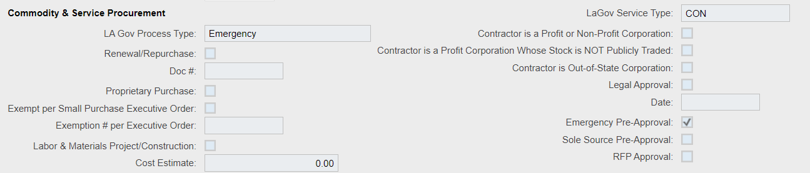
Emergency LaGov Shopping Cart
Navigate to : Item overview – Details – Item Data – LaGov Service Type and LaGov Process Type
Navigate to: Item Overview – Details – Agency
Notes:
List examples

Slide 29
What is a Sole Source?
Only one source exists for the services requested by the using agency
Sole Source contracts are authorized by La. R.S. 39:1600E, La. R.S. 39:1619B(1) and LAC 34:V.901
Notes:
List examples

Slide 30
Sole Source Examples
Contractor is the only entity that provides the scope of services required by the using agency
Contractor is the owner of the source code or proprietary software
Contractor is the single source with the unique capabilities to perform the service
Notes:
List examples

Slide 31
Submitting Sole Source Contracts to OSP
LaGov Agencies
Create an Sole Source Shopping Cart for pre-approval
Make sure to check sole source box when creating shopping cart
Submit with Required Documents
ProAct Agencies
Create a Pre-Approval Transmittal
Submit with Required Documents

Slide 32
Sole Source Contracts – Required Documents
Request letter signed by agency head which should include:
Why the agency believes the situation qualifies as a sole source
The letter must address whether any other sources exist for the requested services
Explains why the services are necessary for the agency and why a competitive process is not warranted

Slide 33
Sole Source – Required Documents
Vendor Letter stating they are a sole source for requested service
A proposed draft contract (unsigned) that includes the proposed terms and amount
Other supporting information for Sole Source (Grant documents, Research, Determinations by other government entities)
Six years of past contract history for services being requested
If applicable, the date of the most recently completed RFP
Cost justification

Slide 34

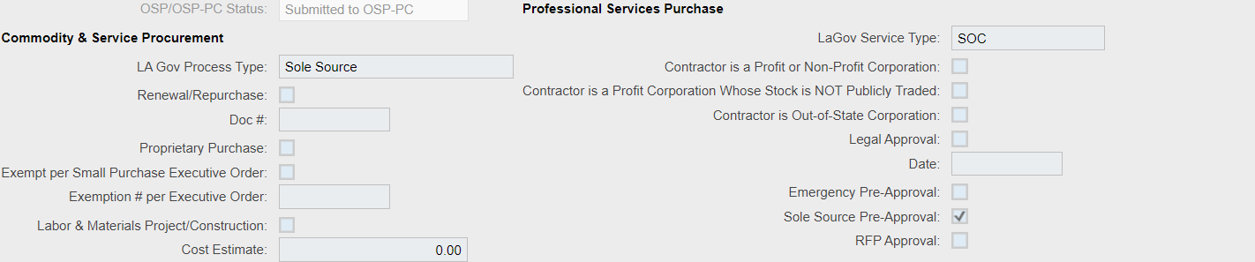
Sole Source LaGov Shopping Cart
Navigate to : Item overview – Details – Item Data – LaGov Service Type and LaGov Process Type
Navigate to: Item Overview – Details – Agency
Notes:
List examples

Slide 35
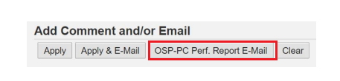
Performance Evaluation
Must be done within 60 days of completion of services
Agency has FULL responsibility for contract administration and monitoring
If your contract/amendment was approved by OSP-PC, a copy MUST be sent to OSP-PC
Open PO
Click on Approval Notes and Attachments
In comment box, type “Performance Evaluation”
Click OSP-PC Perf. Report E-Mail
Attachment the Performance Evaluation
Click send
Notes:
The performance evaluation requirement also includes contracts and amendments approved under your agency’s DPA

Slide 36
Common Mistakes
Missing Information
Act 87
Previous Contract
Purchase Order Number on BA-22
Performance Evaluation
Out of State Justification
Public Contract Description

Slide 37
Helpful Links
Civil Service Contract Exemptions
Louisiana Secretary of State
Louisiana Law Search
OSP Website
LaGov eProcurement

Slide 38
OSP Contact Information
OSP Website procurement.la.gov
LESA Inquiries (RFPs) LESA@la.gov
Professional Contracts doa-pchelpdesk@la.gov
Purchasing doa-osphelpdesk@la.gov
Vendor vendr_inq@la.gov
OSP Main Desk (225) 342-8010
Notes:
Mention how PC team is broken down by agency. Agency assignments can be found on website

