Slide 1

Water Sector Program (WSP)
Grant Implementation
Phase 2
FY 2025-2026

Slide 2
Presentation
This presentation is available on our website on the Water Sector Program-Phase 2 page.
The recording will be posted to our YouTube channel and linked on the website as well.
Questions should be entered in Q and A. Please enter your name and email address with your question in case we are unable to answer your question and need to follow up after the webinar.
Participants must type their name and the system name in the chat box. This is how we are documenting attendance for this webinar. If you do not enter this information in the chat box, we will not be able to document that you were in attendance.

Slide 3
Agenda
Where we are now
Revisions
Grant conditions
Extensions
Permission to bid
Requests for payment
Change Orders
Closeout

Slide 4
Where we are now
Awards issued August 8, 2025
Authorization to incur costs and Grant conditions issued September 2, 2025
Water Sector Program page on OCD-LGA website: https://www.doa.la.gov/doa/ocd-lga/water-sector-program-phase-1-and-phase-2/water-sector-program-phase-2/

Slide 5
Revisions
Notify OCD-LGA if there are revisions needed to the grant agreement, such as Chief Executive Officer or address.

Slide 6
Grant Conditions – issued in Authorization to Incur Costs and Grant Agreement with Conditions (AIC GC) Letter
Grant Agreement
Supplemental Information Page
Financial Management Questionnaire
Performance Schedule
Plans and Specifications
Rate Study
Matching Funds Documentation
Consolidation Documents
Acquisition Timeline

Slide 7
Important notes
Under no circumstances should the grant recipient advertise for bids or begin construction on an activity at this time. Written authorization will be provided from this office to advertise for bids when funds have been released and the plans and specifications for the project have been reviewed and approved.
Funds will not be released until the conditions included in the Grant Conditions letter have been submitted and approved/cleared by this office. If revisions are required, this must be completed within the deadline.
Grantees are encouraged to clear conditions as soon as possible!
Any extensions to deadlines to clear grant conditions must be approved by the Water Sector Commission.

Slide 8
Grant Agreement – Due within 2 months
Review information identifying your system.
CEO should sign the agreement.
Return hard copy to OCD-LGA.

Slide 9
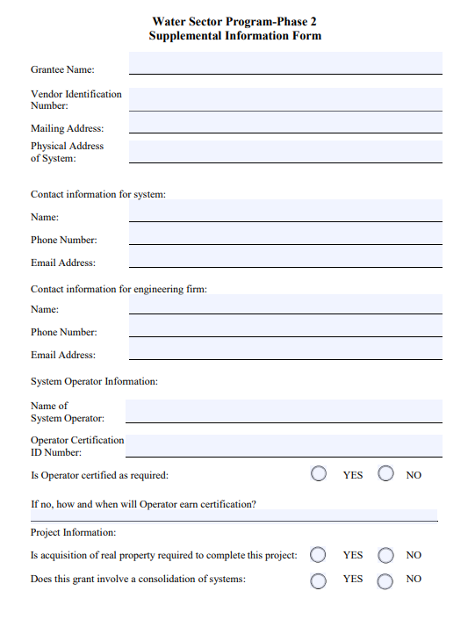
Supplemental Information Page – Due within 2 months

Slide 10
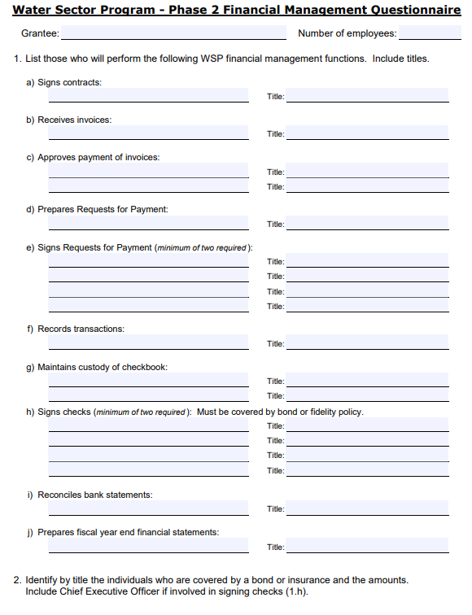
Financial Management Questionnaire – Due within 2 months

Slide 11
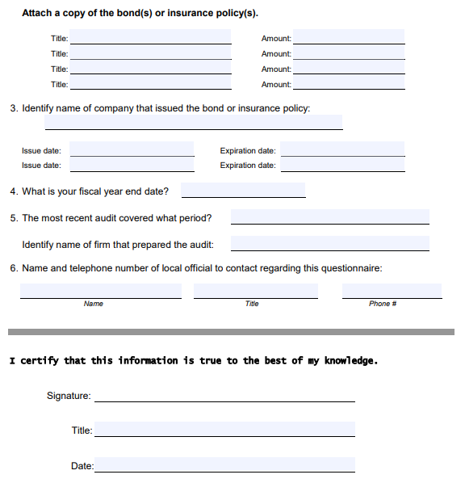
Financial Management Questionnaire – Due within 2 months

Slide 12
Performance Schedule – Due within 2 months
This document will be used to monitor the progress of the project.
The WSP - P2 grant agreement references the performance schedule and OCD-LGA uses it to monitor the program’s progress. Grantees must adhere to this schedule. The quarters are indicated on the performance schedule and coincide with the four quarters in the State’s fiscal year. The completed schedule should begin with the quarter in which the date of authorization to incur costs occurs. This date must be entered in the space provided on this form. The WSP - P2 may have a duration period up to three years (twelve quarters). The entries on this document should begin with the quarter where the authorization to incur costs date lies and not exceed three years from that date. For example, an authorization to incur costs date of April 1, 2025 would begin entries to this document in quarter four and not exceed quarter fifteen.
When completing this form, identify each activity as it corresponds to the line item budget in the WSP - P2 grant agreement. For example, the completion of a sewer project could involve the activities of acquisition, sewer construction, and engineering services. Under each activity, indicate when completion of major project milestones is expected. For example, milestones could be acquisition of easements, engineering, bid advertisement/award, construction, acceptance of work, and release of liens. Consider the activities and decide what major tasks must be accomplished to complete them. List these tasks as milestones under each activity. Then indicate by lines on the schedule showing when these tasks will occur. Be mindful of the grant process that must be followed if this project is funded when drafting the timeline.
For each activity also estimate projected expenditures by dollar amount for each quarter. The expenditures should reflect all funds (WSP P-2 and other) being used to complete the activity. Distinguish between the funds by source and amount.
If more space is needed, attach additional sheets.

Slide 13
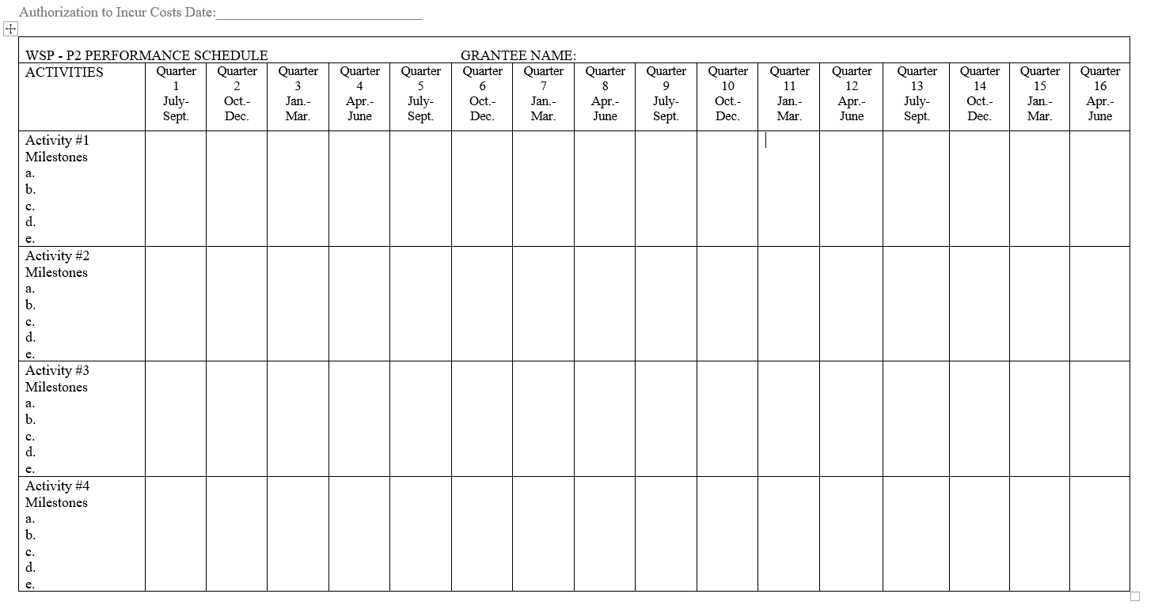
Performance Schedule – Due within 2 months

Slide 14
Plans and Specifications – Due within 6 months
Copy of final plans and specifications plus a final cost estimate must be submitted to the Louisiana Department of Health (LDH) for water projects and Department of Environmental Quality (DEQ) for wastewater projects within six (6) months of the date of the WSP-P2 AIC and GC Letter.
OCD-LGA must be notified in writing that all required documents have been submitted to LDH/DEQ within this time period.
A final cost estimate should be submitted with the notification to OCD-LGA. Plans and specs do not have to be submitted to OCD-LGA.
OCD-LGA will follow up with LDH/DEQ to ensure that all projects approved in the WSP application have been included in the final plans and specifications.

Slide 15
Rate Study – Due within 6 months
OCD-LGA is in the final stages to hire firms to work with WSP-P2 grantees on the completion of rate studies and any actions needed.
OCD-LGA will assign a firm to work with each grantee based on the complexity of the project and capacity or conflicts with the firm. The firm will contact the grantee to begin the process.
Grantees that meet all grant conditions with the exception of the completion of the rate study may request to move forward with bidding by submitting a certification regarding the rate study.
All grantees will be required to participate in this process. If a grantee has completed a rate study on or after July 1, 2024, this document can be reviewed by the assigned rate study to ensure it meets the WSP-P2 requirements.

Slide 16
Matching Funds Documentation – Due within 2 months
Documentation identifying the matching funds as being available to be spent must be submitted.
The specific documentation required will vary depending on the matching funds source.

Slide 17
Consolidation Documents – Due within 2 months
If the approved project involves consolidation with another system or systems, the executed agreement between the systems that memorializes consolidation must be submitted to OCD-LGA.

Slide 18
Extension Requests Regarding Grant Condition Deadlines
All extensions must be approved by the Water Sector Commission.
Grantee must submit a letter requesting the extension that includes an explanation of the need for the extension and the length of the extension.
Grantee may be required to appear before the Water Sector Commission to discuss the request.

Slide 19
Permission to bid
Permission to bid will be given to grantees when all grant conditions have been cleared/approved and LDH/DEQ has notified OCD-LGA that all projects included in the approved WSP application have been included in the plans and specifications submitted for review.
Grantees will be required to advertise for bids within 30 days of being given permission to bid.
Upon receipt of bids and award of contract, Grantees must complete the Notice of Contract Award form and email to Suzanne.Bentley-Smith@LA.GOV and OCD.WSP@la.gov
Any project that has not awarded a construction contract two years from the date of the grant award will be terminated unless an exception has been requested and approved by the Commission.

Slide 20
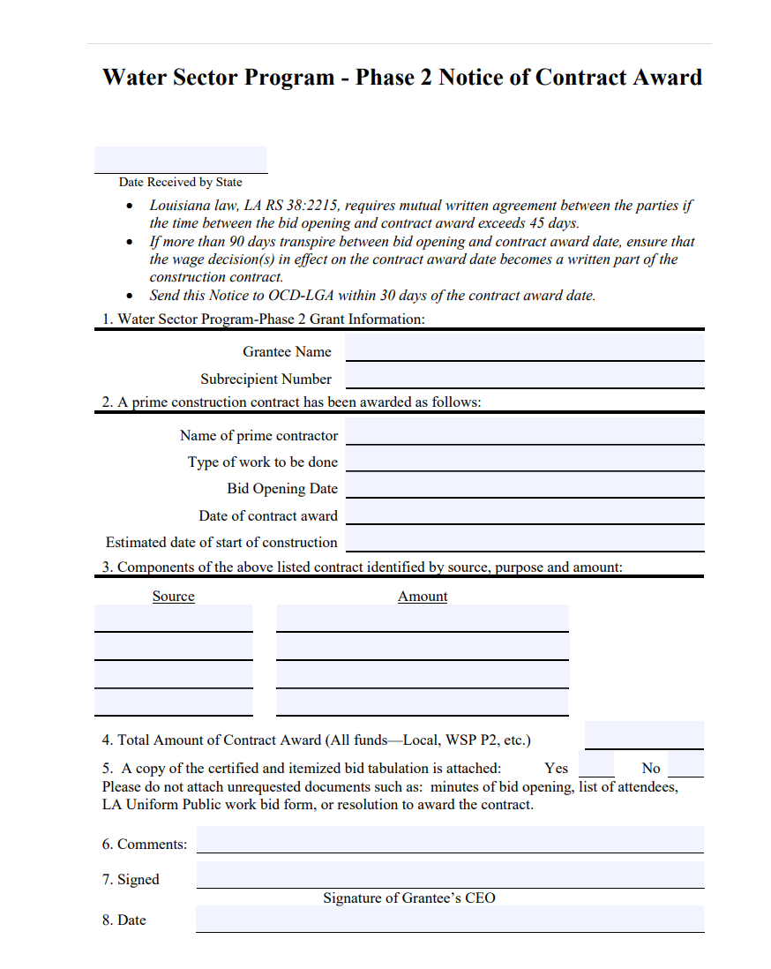
Notice of Contract Award

Slide 21
Request for Payment
All grantees are required to sign up for EFT. Enroll vendor number for electronic funds transfer with the Office of Statewide Reporting and Accounting Policy.
If your project involves funds from the Clean Water Revolving Loan Fund or the Drinking Water Revolving Loan Fund, then documentation from LDH or DEQ indicating the program personnel have reviewed the Request for Payment must be included in the submission to OCD-LGA. Payments will not be approved until this documentation is received.
We will take into account any match that is listed on the RFP form when calculating the WSP payment; however, the funds will not be identified as documented unless we have the required documents.

Slide 22
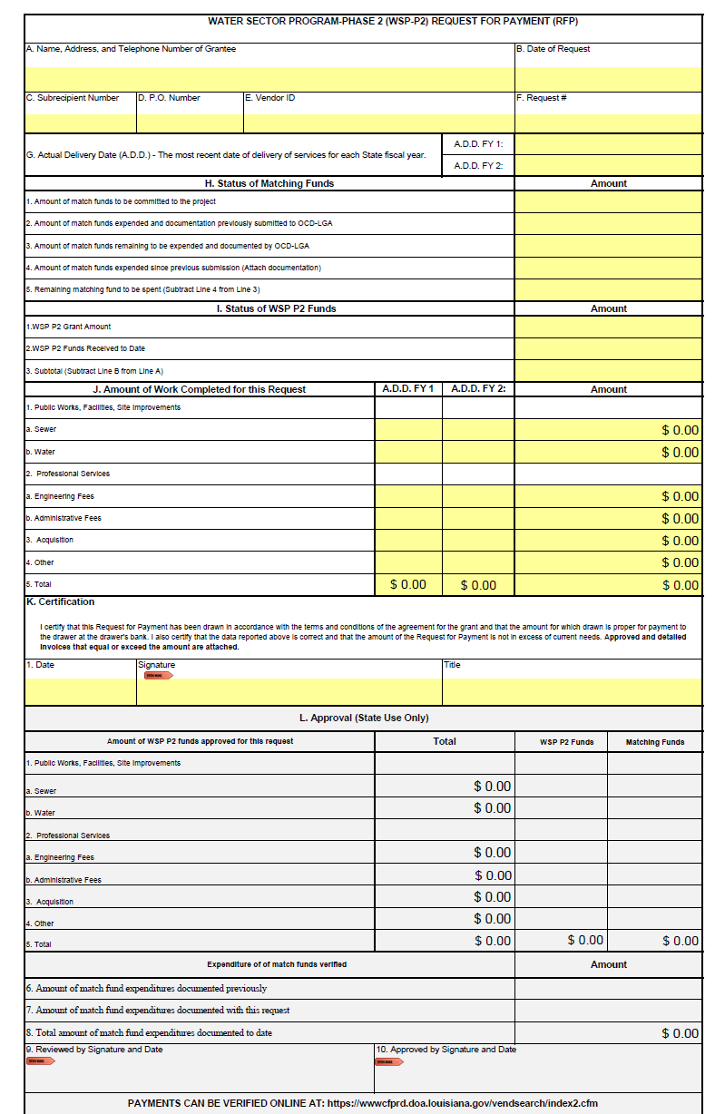
How to request payment
https://get.adobe.com/reader/
Email the completed RFP to the OCDLGA.PaymentRequests@la.gov only
RFP Form can be found on the WSP P2 webpage

Slide 23
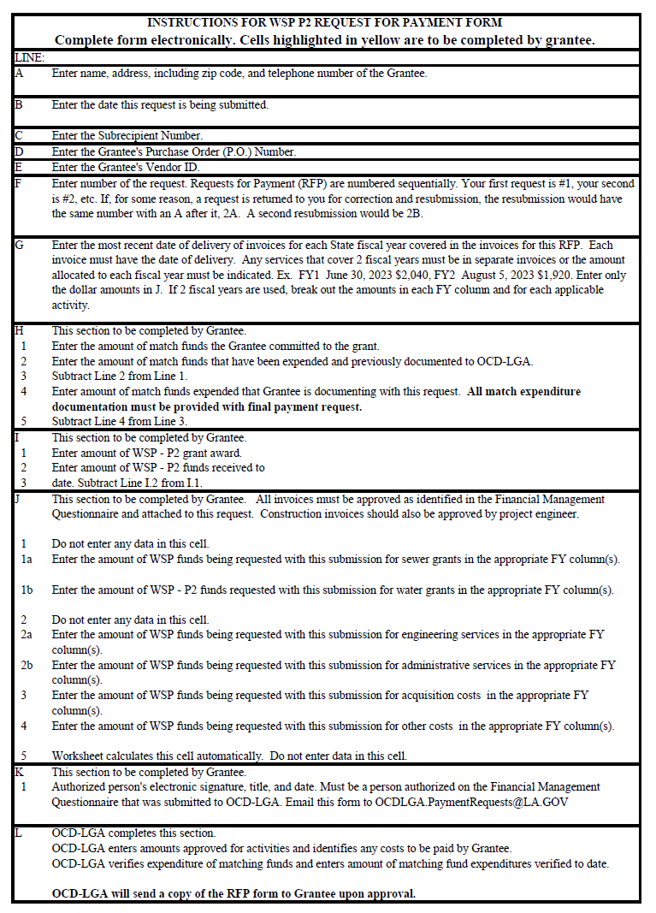
Instructions for WSP P2 Request for Payment Form

Slide 24
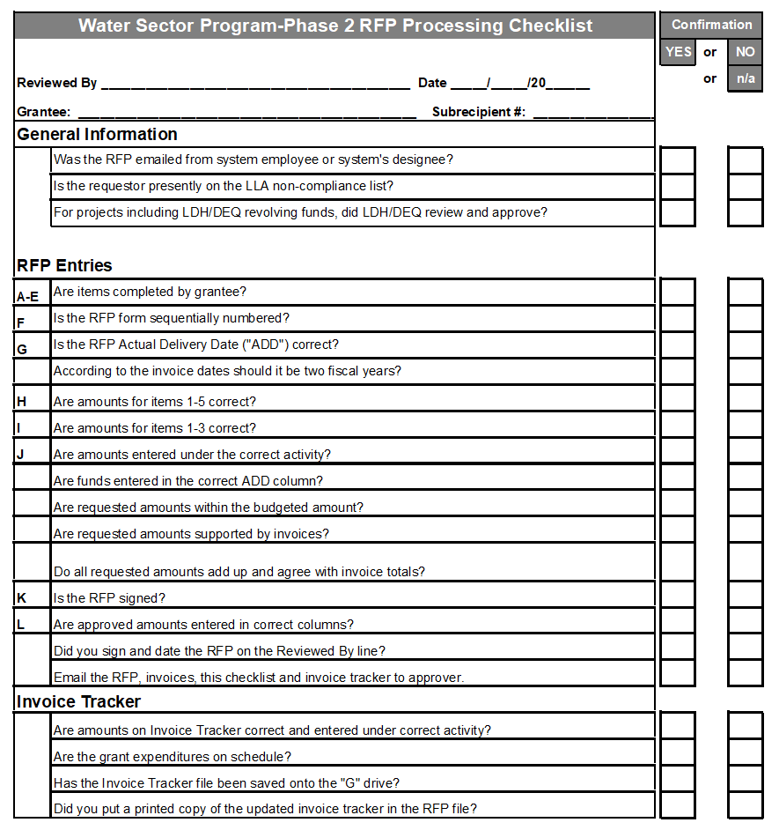
Checklist used by OCD-LGA Staff to review RFPs for processing

Slide 25
Documentation of Match Funds
Grantees will be required to provide documentation of the expenditure of match funds in accordance with the approved application.
Invoices paid and cancelled checks showing payment of invoices must be submitted to document match.
Match funds documentation can be submitted at any time during the grant implementation process, but must be submitted prior to OCD-LGA approving the final request for payment.
Any percentage calculated to exceed 76% will be reported as 76% for reimbursement purposes.

Slide 26
Change Orders
Change orders should be submitted to Suzanne.Bentley-Smith@la.gov and OCD.WSP@la.gov
All scope changes are reviewed by LDH or DEQ.
If a scope change is involved, the request will go before the WSC.
If the change order adds more than 60 days cumulatively, the request goes before the WSC.
Additional funding requests cannot be considered under this program.

Slide 27
Closeout
When 80% of grant funds have been expended, OCD-LGA will send the Grantee a Completion Report that must be completed by the Grantee and submitted to OCD-LGA for review and approval.
Upon expenditure of all grant funds and with the receipt of a correct Completion Report, OCD-LGA will issue a “Grant Closeout Approval” letter.
Grantees will be required to have a certified operator on the staff operating the system prior to closing out the grant with the State.

Slide 28
Final Notes
Grant agreements are for three years. The entire project must be completed within that timeframe.
Improvements to the WSP Portal are ongoing. Grantees will be notified of any changes to the procedures included in this presentation.
Any other requests for consideration by the Water Sector Commission must be sent to Heather.Paul@la.gov, Suzanne.Bentley-Smith@la.gov, and OCD.WSP@la.gov

Slide 29
Contact Information – WSP Phase 2
  Gina Campo, OCD Executive Director
    Gina.Campo@la.gov
    (225) 219-9600
  Heather Paul, OCD-LGA Director
    Heather.Paul@la.gov
    (225) 342-0148
  Suzanne Bentley-Smith, Grant Representative
    Suzanne.Bentley-Smith@la.gov
    (225) 219-0805

Slide 30

Questions?

